Slide 1

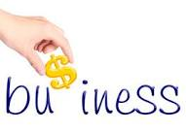

Slide 2
Lesson 01
Understanding Basic Business Concepts

Slide 3
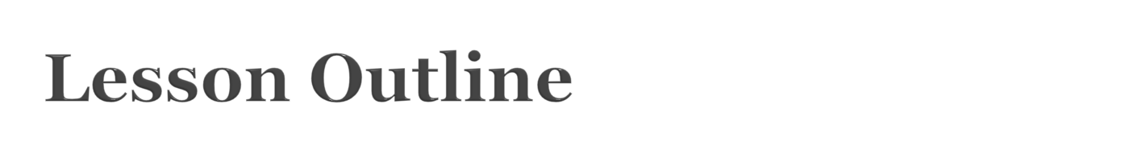
Concept of Capital
Concept of Profit and Service
Concept of Assets and Liabilities
Risk and Distribution
Concept of Sustainability

Slide 4

What comes instantly to your mind?
I bet it’s financial
It is that part of the wealth that goes in to the systems of accumulating wealth

Slide 5
Characteristic : Capital is not going to be used up in the production / conversion process
Is everything that goes in to the process of converting its input to its desired output / outcome
Knowledge
machinery
Finance
Conversion
Input:
Raw materials
Output:
Product / Service
Special skills
Patents
Land

Slide 6

Financial capital
  In form of money usually traded / invested in monitory markets
Ecological / natural capital
  Natural things that helps increasing wealth
Social capital
  Among the societies and relationship. What relationships brings in. E.g. brand equity, supply chain relationships, strategic alliance
Intellectual capital

Slide 7

Collective knowledge used in an organization. Is of three forms
  Customer capital
    Relationship with the customers. E.g. loyalty, customer lifetime value
  Human capital
    That part of human that enhances the potential of the organization’s processors. E.g. motivation, productivity, satisfaction
  Structural capital
    Not in the heads of humans…intangible things remain in the organizations when humans are removed. E.g. policies, systems, patents

Slide 8
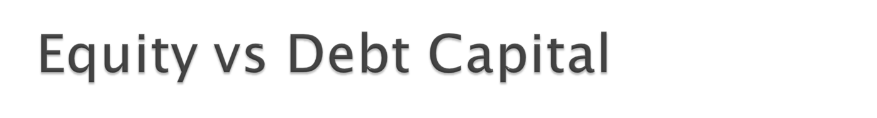
Equity capital
  The organization doesn’t have to pay back
  Owners capital
  Have more privileges
Debt capital
  Capital borrowed from other parties
  Have to repay
  No ownership attached

Slide 9
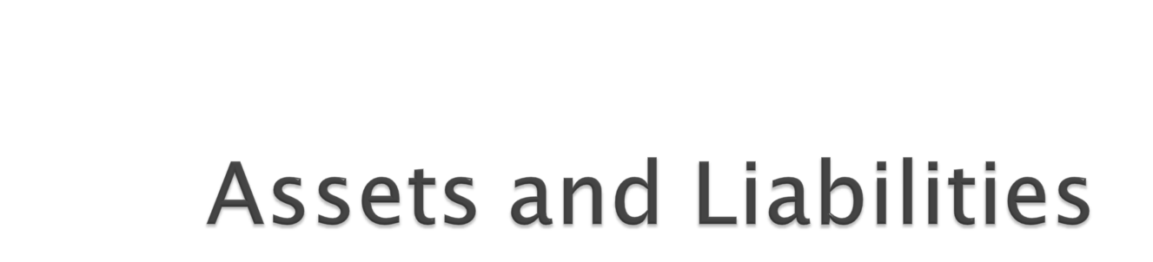

Slide 10
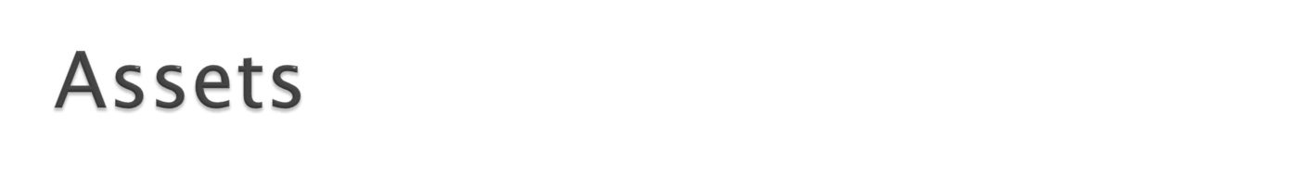
Things an organizations possess or have control over that will bring benefits to the organization
Cash in flows
Liability reduction
Increase of sales
Improvement of brand image
They are the storages of wealth accumulated by organizations

Slide 11

It has an economic value and/or economic value to the organization
It should be owned or have the right to access by the organization
Can be converted to cash
Disposal of which will bring money to the organization

Slide 12

Long-term
  E.g. buildings, machinery
Short-term
  E.g. pre-paid bills, debtors
Financial assets
Intangible assets
  E.g. patents, copy rights, brand name

Slide 13

Obligation to settle in future as a result of past activity. Thus, it is a scarification of future economic value in settlement of past obligation

Slide 14
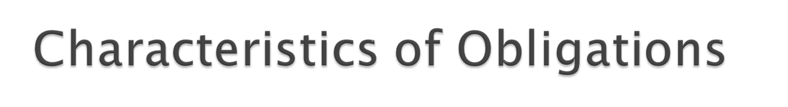
Legally biding
In most situations, it is as a result of acquisition of things that brings economic value
Disposal of which results in reduction of assets.
It’s future realization. So connects past and future

Slide 15

Every wealth accumulated / generated in the organization is not for the owners
Significant portion spreads through different entities of the organization
Some gets into the operations inform of expenses, others gets converted to new assets, while some will be used in settlements
Need to have an understanding of the spread

Slide 16
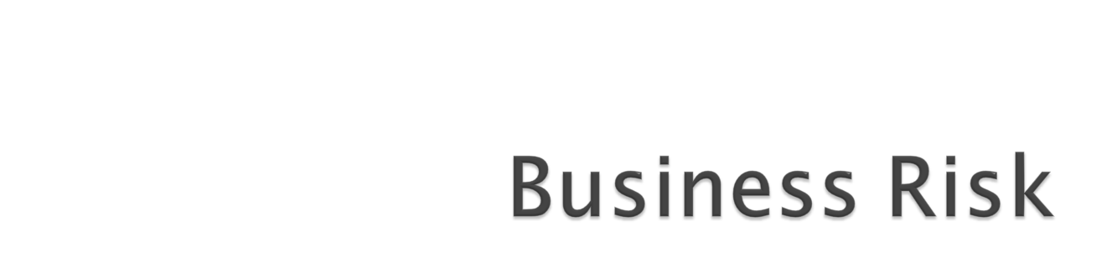

Slide 17
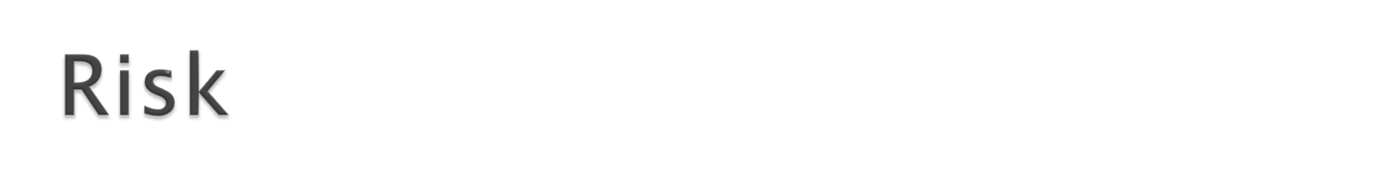
Possibility of harmful and beneficial outcomes with a probability of occurrence
  E.g. possible financial losses
  Not being able to pay off debts
  Not getting the expected market share
Risk is there, because we don’t know

Slide 18

Speculative risk
  Risk of gaining or making losses
  Organizations take these type of risks to make profits
    E.g. entering to the international market
    Invest in new R&D
Pure risk
  Risk of losing without possible gain
    Natural risk
    Economic risk
    Human risk

Slide 19
Economic risk
  Due to the changes in the business environment
    E.g. new competition
    Product obsolesce
    Lifestyle changes
    Government policy changes
    Economic recession
Human risk
  Due to humans such as employees and the customers
    E.g. work hazard
    Thefts

Slide 20
Business should constantly assess different kinds of risk they may face and introduce mechanism/systems to reduce the risk
Understanding of the consequences If unfavorable situation occurs and way to avoid them
  E.g. business format – partnerships vs limited liability companies
  Insurance

Slide 21
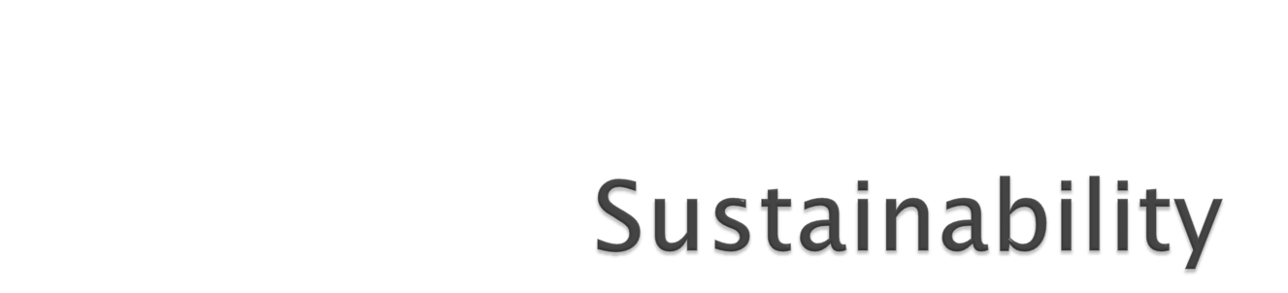

Slide 22

Businesses that do not compromise the future societies through their operations
Have minimum negative impact on environment, societies and economies
Broader value generation
Green businesses

Slide 23
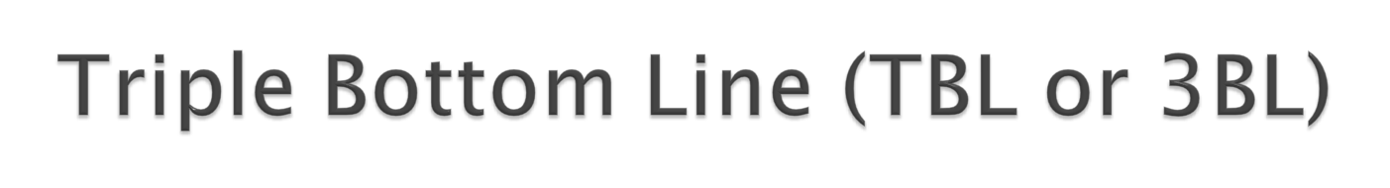
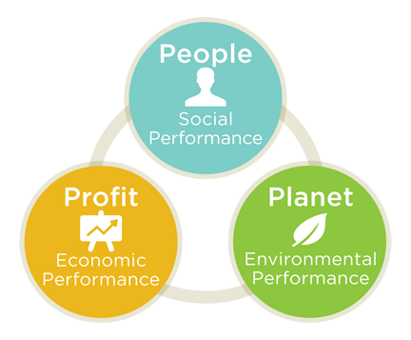
Organizational three dimensional performance
In addition to traditional bottom line; “Profit”
Two other bottom lines are considered; “People” and “Planet”

Slide 24

Carbon Foot Print
Global warming potential

